Slide 1
The basics of analyzing nanopore sequencing data: extracting quality scores from .fastq files
Jason A. Hendry, 2020/07/25

Slide 2
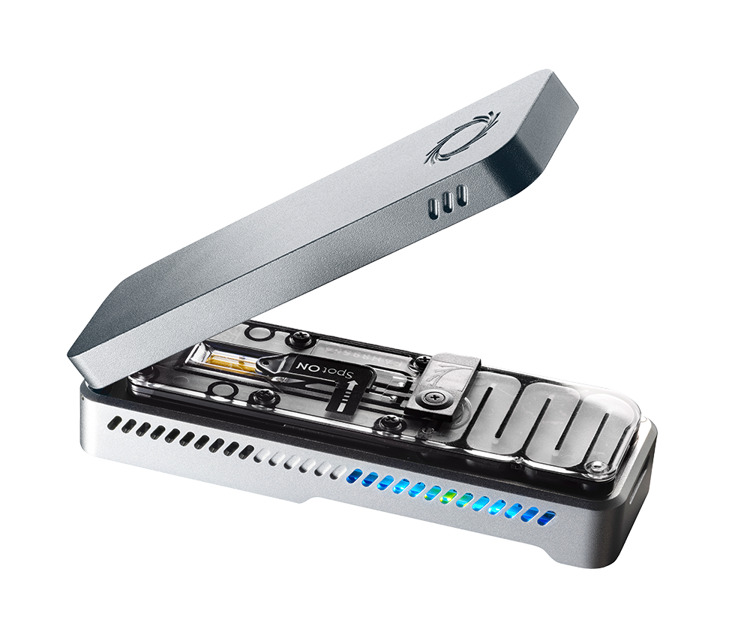
The data analysis pipeline Overview of steps and file types
(3) Adapter trimming &
demultiplexing
(5) Data compression & organization
(1) Sequencing
Tables (.csv),
Plots (.pdf/.png),
&c.
.fast5
.fastq
.fastq
.sam
.bam
(2) Basecalling
(4) Mapping
(6) Expt.
specific
analysis

Slide 3
The data analysis pipeline Overview of steps and file types
samtools
(3) Adapter trimming &
demultiplexing
(5) Data compression & organization
(1) Sequencing
Tables (.csv),
Plots (.pdf/.png),
&c.
.fast5
.fastq
.fastq
.sam
.bam
(2) Basecalling
(4) Mapping
(6) Expt.
specific
analysis
All performed by MinKNOW
Minimap2
Python, R, &c.

Slide 4
The data analysis pipeline Overview of steps and file types
Your script(s)! Can be Python, R, bash, &c.
samtools
(3) Adapter trimming &
demultiplexing
(5) Data compression & organization
(1) Sequencing
Tables (.csv),
Plots (.pdf/.png),
&c.
.fast5
.fastq
.fastq
.sam
.bam
(2) Basecalling
(4) Mapping
(6) Expt.
specific
analysis
All performed by MinKNOW
Minimap2
Python, R, &c.

Slide 5
The .fastq How data on sequencing reads is stored
Produced directly by the sequencer (Illuminia, nanopore, &c.)
Just a text file
Instead of read.txt it is saved as read.fastq
Stores information about each read:
The sequence
How confident the sequencer was in calling the sequence
Stored in standardized way
Four lines, repeated for each read

Slide 6
The .fastq How data on sequencing reads is stored
@read001-2020-09-25-15:33
ATCGTCGCGTTGCTCCGATAGT
+
)('")&+)13;7:<>.&+)-00
Read Specific Identifier
Nucleotide Sequence
”+”
ASCII-Encoded Error Probabilities
@read002-2020-09-25-15:35
TTCGTGGTGAGTGA
+
)('")&+5/)*11*
@read003-2020-09-25-15:37
TTCGTGGTTGTGTTTTTCGTTG
+
)('")&+5/)*11*7;6;31,/

Slide 7
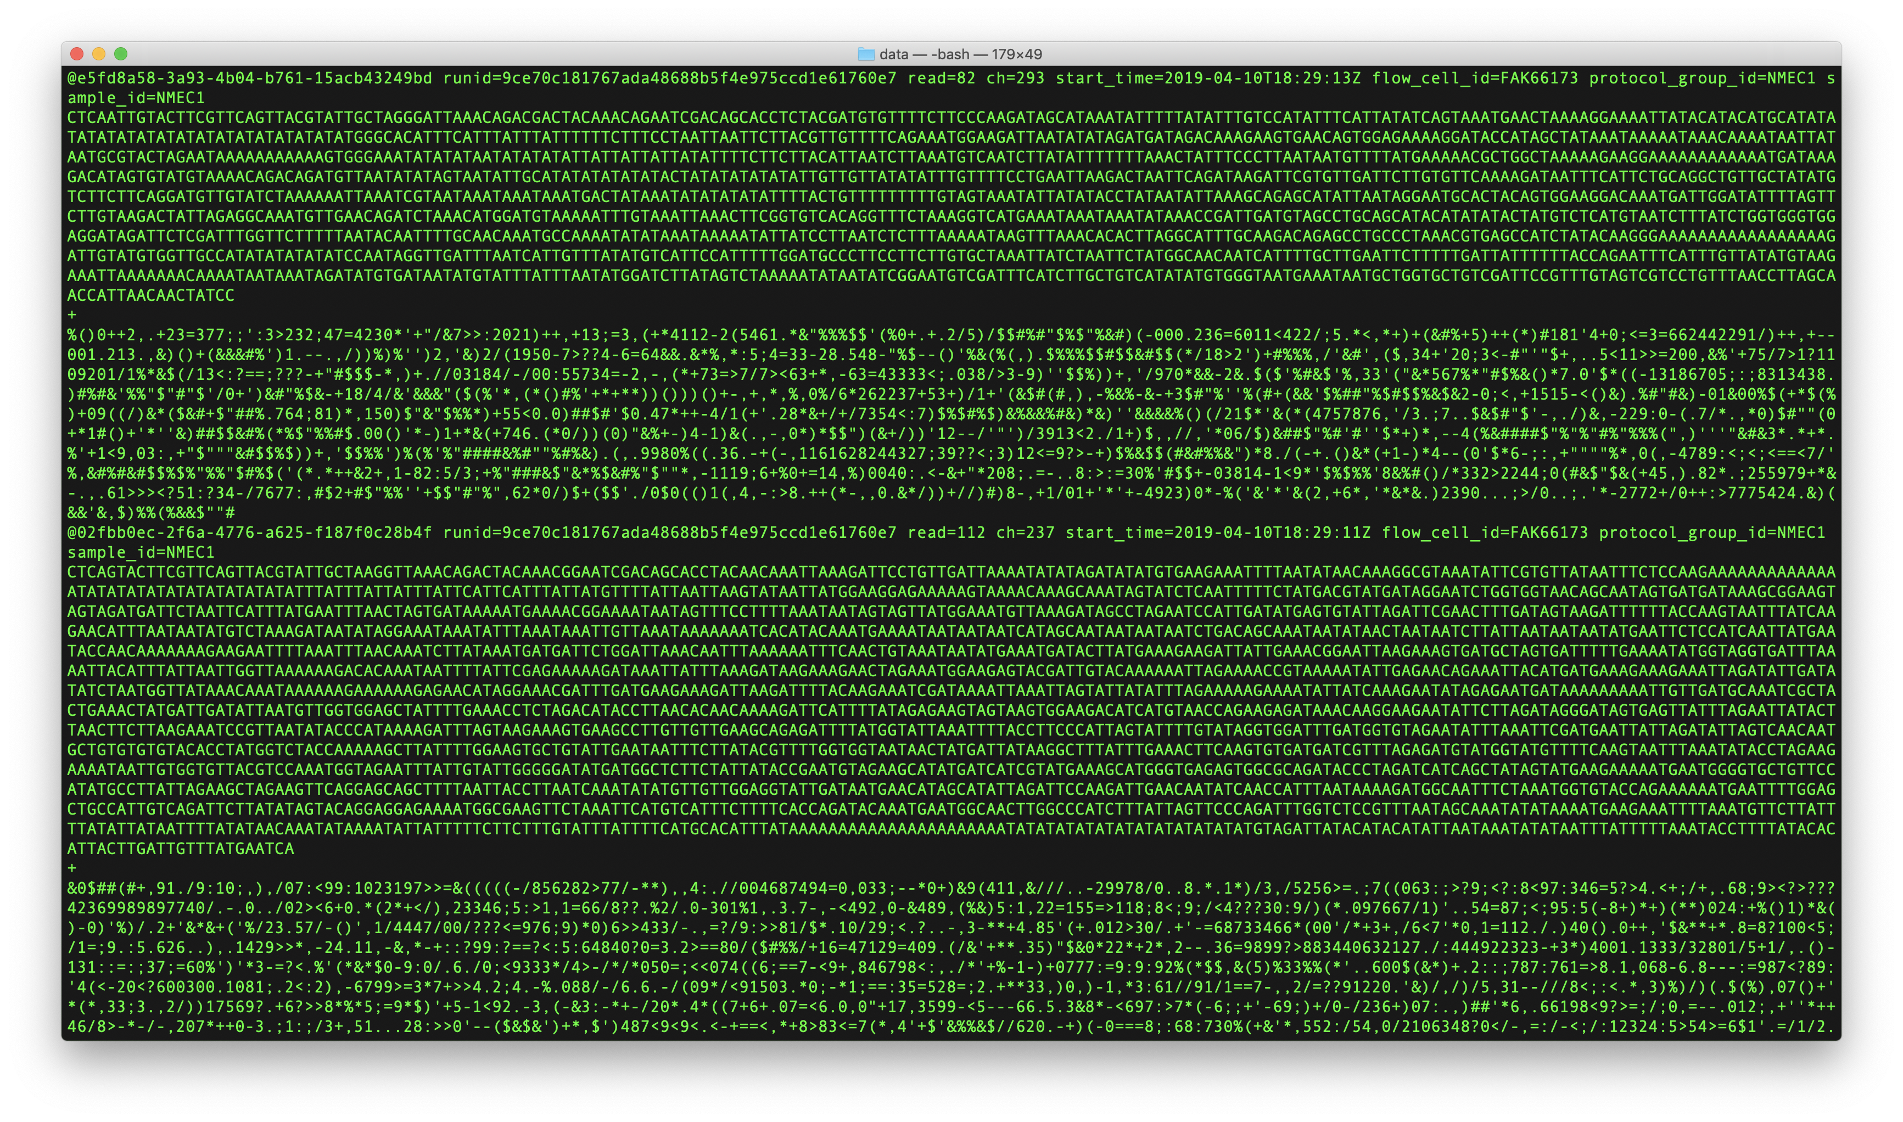
The .fastq What are the error probabilities?

Slide 8
The .fastq Error probabilities are encoded by one character
@read001-2020-09-25-15:33
ATCGTCGCGTTGCTCCGATAGT
+
)('")&+)13;7:<>.&+)-00
Encodes probability that nucleotide is wrong
Where do they come from?

Slide 9
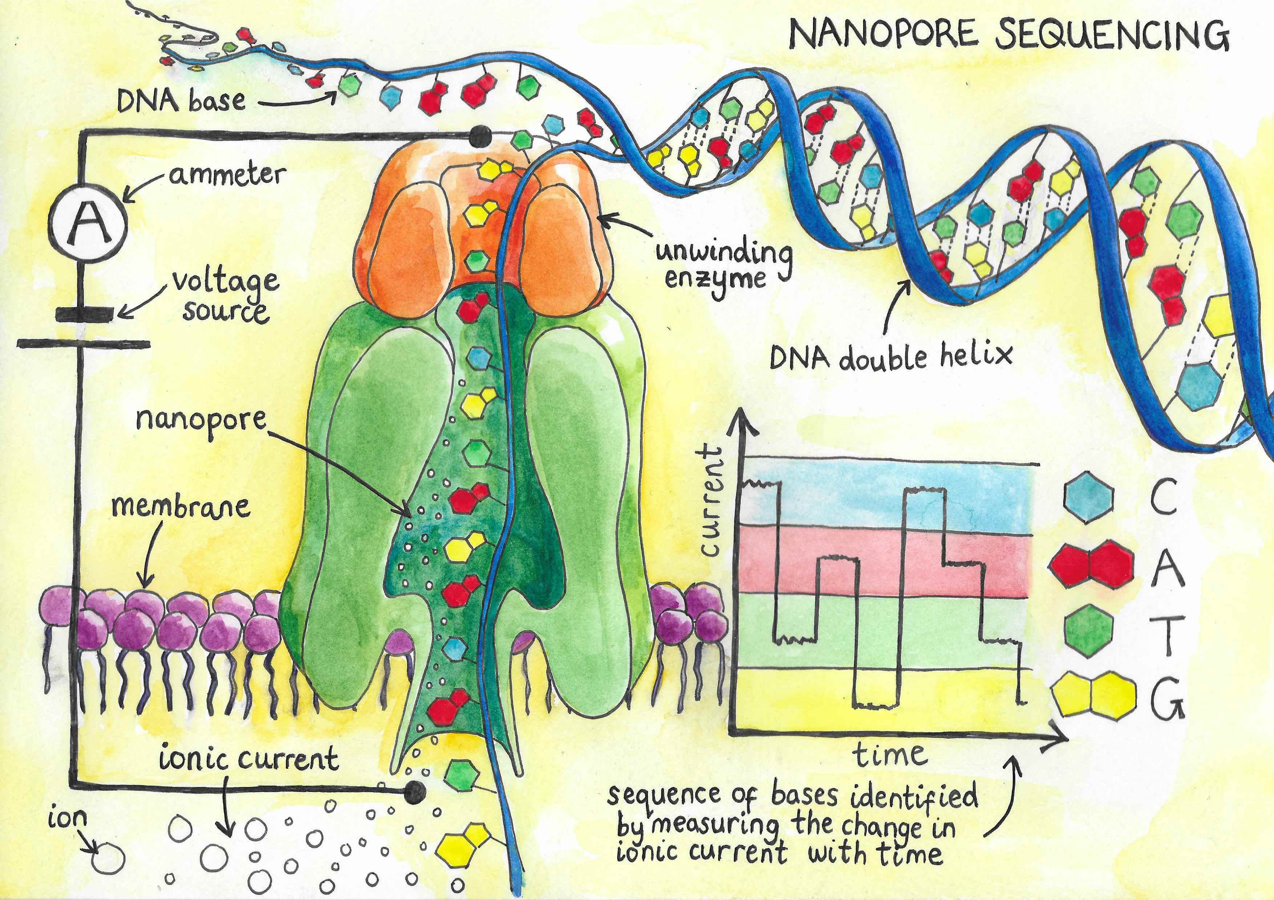
The .fastq Error probabilities are encoded by one character
Nucleotides:
#1
#2
A 0.02
T 0.01
C 0.96
G 0.01
A 0.02
T 0.58
C 0.01
G 0.39
P(error) = 0.04
P(error) = 0.42

Slide 10
The .fastq Error probabilities are encoded by one character
@read001-2020-09-25-15:33
ATCGTCGCGTTGCTCCGATAGT
+
)('")&+)13;7:<>.&+)-00
Encodes probability that nucleotide is wrong
These symbols represent error probabilities
Each nucleotides error probability represented by one character / symbol
How?

Slide 11
The .fastq Error probabilities are encoded by one character
ATTC
The error probability is the probability that the nucleotide is wrong.
Probabilities are between 0 and 1.
They are also continuous e.g. 0.06328782382738232 is a valid probability.
0.05
How can we represent them with one character?

Slide 12
The .fastq Error probabilities are encoded by one character
ATTC
The error probability is the probability that the nucleotide is wrong.
Probabilities are between 0 and 1.
They are also continuous e.g. 0.06328782382738232 is a valid probability.
0.05
How can we represent them with one character?
Two step solution….

Slide 13
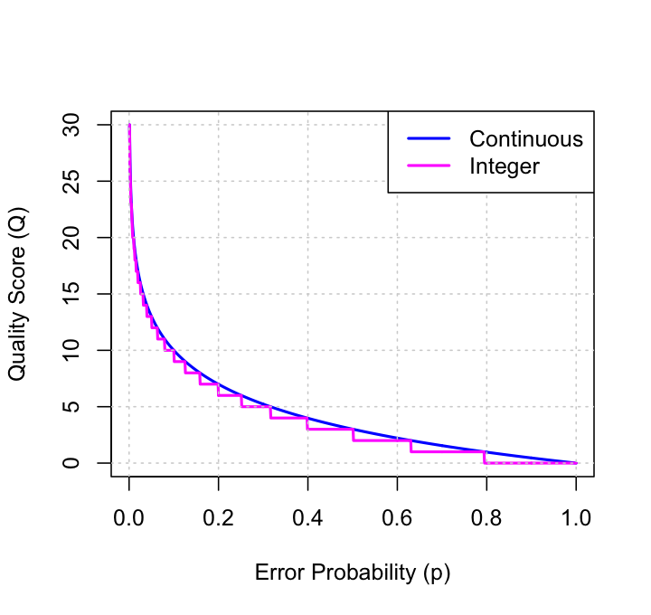

The .fastq How can we map probabilities to one character?
ATTC
Step 1. Convert to quality scores
$$Q=−10\log_{10}{p}$$
Q | p
10 | 0.1
20 | 0.01
30 | 0.001
40 | 0.0001
0.05

Slide 14
The .fastq How can we map probabilities to one character?
ATTC
Step 1. Convert to quality scores
$$Q=−10\log_{10}{p}$$
Q | p
10 | 0.1
20 | 0.01
30 | 0.001
40 | 0.0001
13
0.05

Slide 15
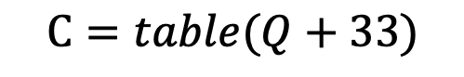
The .fastq How can we map probabilities to one character?
ATTC
Step 1. Convert to quality scores
$$Q=−10\log_{10}{p}$$
ASCII TABLE
Char | Dec | Binary | Char | Dec | Binary | Char | Dec | Binary
! | 33 | 100001 | A | 65 | 1000001 | a | 97 | 1100001
" | 34 | 100010 | B | 66 | 1000010 | b | 98 | 1100010
# | 35 | 100011 | C | 67 | 1000011 | c | 99 | 1100011
$ | 36 | 100100 | D | 68 | 1000100 | d | 100 | 1100100
% | 37 | 100101 | E | 69 | 1000101 | e | 101 | 1100101
& | 38 | 100110 | F | 70 | 1000110 | f | 102 | 1100110
' | 39 | 100111 | G | 71 | 1000111 | g | 103 | 1100111
( | 40 | 101000 | H | 72 | 1001000 | h | 104 | 1101000
) | 41 | 101001 | I | 73 | 1001001 | i | 105 | 1101001
* | 42 | 101010 | J | 74 | 1001010 | j | 106 | 1101010
+ | 43 | 101011 | K | 75 | 1001011 | k | 107 | 1101011
, | 44 | 101100 | L | 76 | 1001100 | l | 108 | 1101100
- | 45 | 101101 | M | 77 | 1001101 | m | 109 | 1101101
. | 46 | 101110 | N | 78 | 1001110 | n | 110 | 1101110
/ | 47 | 101111 | O | 79 | 1001111 | o | 111 | 1101111
0 | 48 | 110000 | P | 80 | 1010000 | p | 112 | 1110000
1 | 49 | 110001 | Q | 81 | 1010001 | q | 113 | 1110001
2 | 50 | 110010 | R | 82 | 1010010 | r | 114 | 1110010
3 | 51 | 110011 | S | 83 | 1010011 | s | 115 | 1110011
4 | 52 | 110100 | T | 84 | 1010100 | t | 116 | 1110100
5 | 53 | 110101 | U | 85 | 1010101 | u | 117 | 1110101
6 | 54 | 110110 | V | 86 | 1010110 | v | 118 | 1110110
7 | 55 | 110111 | W | 87 | 1010111 | w | 119 | 1110111
8 | 56 | 111000 | X | 88 | 1011000 | x | 120 | 1111000
9 | 57 | 111001 | Y | 89 | 1011001 | y | 121 | 1111001
: | 58 | 111010 | Z | 90 | 1011010 | z | 122 | 1111010
; | 59 | 111011 | [ | 91 | 1011011 | { | 123 | 1111011
< | 60 | 111100 | \ | 92 | 1011100 | | | 124 | 1111100
= | 61 | 111101 | ] | 93 | 1011101 | } | 125 | 1111101
> | 62 | 111110 | ^ | 94 | 1011110 | ~ | 126 | 1111110
? | 63 | 111111 | _ | 95 | 1011111 | _ | 127 | 1111111
@ | 64 | 1000000 | ` | 96 | 1100000
Step 2. Convert quality scores
to ASCII characters
13
$$C=table(Q+33)$$
0.05

Slide 16
The .fastq How can we map probabilities to one character?
ATTC
Step 1. Convert to quality scores
.
$$Q=−10\log_{10}{p}$$
ASCII TABLE
Char | Dec | Binary | Char | Dec | Binary | Char | Dec | Binary
! | 33 | 100001 | A | 65 | 1000001 | a | 97 | 1100001
" | 34 | 100010 | B | 66 | 1000010 | b | 98 | 1100010
# | 35 | 100011 | C | 67 | 1000011 | c | 99 | 1100011
$ | 36 | 100100 | D | 68 | 1000100 | d | 100 | 1100100
% | 37 | 100101 | E | 69 | 1000101 | e | 101 | 1100101
& | 38 | 100110 | F | 70 | 1000110 | f | 102 | 1100110
' | 39 | 100111 | G | 71 | 1000111 | g | 103 | 1100111
( | 40 | 101000 | H | 72 | 1001000 | h | 104 | 1101000
) | 41 | 101001 | I | 73 | 1001001 | i | 105 | 1101001
* | 42 | 101010 | J | 74 | 1001010 | j | 106 | 1101010
+ | 43 | 101011 | K | 75 | 1001011 | k | 107 | 1101011
, | 44 | 101100 | L | 76 | 1001100 | l | 108 | 1101100
- | 45 | 101101 | M | 77 | 1001101 | m | 109 | 1101101
. | 46 | 101110 | N | 78 | 1001110 | n | 110 | 1101110
/ | 47 | 101111 | O | 79 | 1001111 | o | 111 | 1101111
0 | 48 | 110000 | P | 80 | 1010000 | p | 112 | 1110000
1 | 49 | 110001 | Q | 81 | 1010001 | q | 113 | 1110001
2 | 50 | 110010 | R | 82 | 1010010 | r | 114 | 1110010
3 | 51 | 110011 | S | 83 | 1010011 | s | 115 | 1110011
4 | 52 | 110100 | T | 84 | 1010100 | t | 116 | 1110100
5 | 53 | 110101 | U | 85 | 1010101 | u | 117 | 1110101
6 | 54 | 110110 | V | 86 | 1010110 | v | 118 | 1110110
7 | 55 | 110111 | W | 87 | 1010111 | w | 119 | 1110111
8 | 56 | 111000 | X | 88 | 1011000 | x | 120 | 1111000
9 | 57 | 111001 | Y | 89 | 1011001 | y | 121 | 1111001
: | 58 | 111010 | Z | 90 | 1011010 | z | 122 | 1111010
; | 59 | 111011 | [ | 91 | 1011011 | { | 123 | 1111011
< | 60 | 111100 | \ | 92 | 1011100 | | | 124 | 1111100
= | 61 | 111101 | ] | 93 | 1011101 | } | 125 | 1111101
> | 62 | 111110 | ^ | 94 | 1011110 | ~ | 126 | 1111110
? | 63 | 111111 | _ | 95 | 1011111 | _ | 127 | 1111111
@ | 64 | 1000000 | ` | 96 | 1100000
Step 2. Convert quality scores
to ASCII characters
13
$$C=table(Q+33)$$
0.05

Slide 17
The .fastq How can we map probabilities to one character?
ATTC
Step 1. Convert to quality scores
.
?
$$Q=−10\log_{10}{p}$$
ASCII TABLE
Char | Dec | Binary | Char | Dec | Binary | Char | Dec | Binary
! | 33 | 100001 | A | 65 | 1000001 | a | 97 | 1100001
" | 34 | 100010 | B | 66 | 1000010 | b | 98 | 1100010
# | 35 | 100011 | C | 67 | 1000011 | c | 99 | 1100011
$ | 36 | 100100 | D | 68 | 1000100 | d | 100 | 1100100
% | 37 | 100101 | E | 69 | 1000101 | e | 101 | 1100101
& | 38 | 100110 | F | 70 | 1000110 | f | 102 | 1100110
' | 39 | 100111 | G | 71 | 1000111 | g | 103 | 1100111
( | 40 | 101000 | H | 72 | 1001000 | h | 104 | 1101000
) | 41 | 101001 | I | 73 | 1001001 | i | 105 | 1101001
* | 42 | 101010 | J | 74 | 1001010 | j | 106 | 1101010
+ | 43 | 101011 | K | 75 | 1001011 | k | 107 | 1101011
, | 44 | 101100 | L | 76 | 1001100 | l | 108 | 1101100
- | 45 | 101101 | M | 77 | 1001101 | m | 109 | 1101101
. | 46 | 101110 | N | 78 | 1001110 | n | 110 | 1101110
/ | 47 | 101111 | O | 79 | 1001111 | o | 111 | 1101111
0 | 48 | 110000 | P | 80 | 1010000 | p | 112 | 1110000
1 | 49 | 110001 | Q | 81 | 1010001 | q | 113 | 1110001
2 | 50 | 110010 | R | 82 | 1010010 | r | 114 | 1110010
3 | 51 | 110011 | S | 83 | 1010011 | s | 115 | 1110011
4 | 52 | 110100 | T | 84 | 1010100 | t | 116 | 1110100
5 | 53 | 110101 | U | 85 | 1010101 | u | 117 | 1110101
6 | 54 | 110110 | V | 86 | 1010110 | v | 118 | 1110110
7 | 55 | 110111 | W | 87 | 1010111 | w | 119 | 1110111
8 | 56 | 111000 | X | 88 | 1011000 | x | 120 | 1111000
9 | 57 | 111001 | Y | 89 | 1011001 | y | 121 | 1111001
: | 58 | 111010 | Z | 90 | 1011010 | z | 122 | 1111010
; | 59 | 111011 | [ | 91 | 1011011 | { | 123 | 1111011
< | 60 | 111100 | \ | 92 | 1011100 | | | 124 | 1111100
= | 61 | 111101 | ] | 93 | 1011101 | } | 125 | 1111101
> | 62 | 111110 | ^ | 94 | 1011110 | ~ | 126 | 1111110
? | 63 | 111111 | _ | 95 | 1011111 | _ | 127 | 1111111
@ | 64 | 1000000 | ` | 96 | 1100000
Step 2. Convert quality scores
to ASCII characters
?
$$C=table(Q+33)$$
0.1

Slide 18
The .fastq How can we map probabilities to one character?
ATTC
Step 1. Convert to quality scores
.
?
$$Q=−10\log_{10}{p}$$
ASCII TABLE
Char | Dec | Binary | Char | Dec | Binary | Char | Dec | Binary
! | 33 | 100001 | A | 65 | 1000001 | a | 97 | 1100001
" | 34 | 100010 | B | 66 | 1000010 | b | 98 | 1100010
# | 35 | 100011 | C | 67 | 1000011 | c | 99 | 1100011
$ | 36 | 100100 | D | 68 | 1000100 | d | 100 | 1100100
% | 37 | 100101 | E | 69 | 1000101 | e | 101 | 1100101
& | 38 | 100110 | F | 70 | 1000110 | f | 102 | 1100110
' | 39 | 100111 | G | 71 | 1000111 | g | 103 | 1100111
( | 40 | 101000 | H | 72 | 1001000 | h | 104 | 1101000
) | 41 | 101001 | I | 73 | 1001001 | i | 105 | 1101001
* | 42 | 101010 | J | 74 | 1001010 | j | 106 | 1101010
+ | 43 | 101011 | K | 75 | 1001011 | k | 107 | 1101011
, | 44 | 101100 | L | 76 | 1001100 | l | 108 | 1101100
- | 45 | 101101 | M | 77 | 1001101 | m | 109 | 1101101
. | 46 | 101110 | N | 78 | 1001110 | n | 110 | 1101110
/ | 47 | 101111 | O | 79 | 1001111 | o | 111 | 1101111
0 | 48 | 110000 | P | 80 | 1010000 | p | 112 | 1110000
1 | 49 | 110001 | Q | 81 | 1010001 | q | 113 | 1110001
2 | 50 | 110010 | R | 82 | 1010010 | r | 114 | 1110010
3 | 51 | 110011 | S | 83 | 1010011 | s | 115 | 1110011
4 | 52 | 110100 | T | 84 | 1010100 | t | 116 | 1110100
5 | 53 | 110101 | U | 85 | 1010101 | u | 117 | 1110101
6 | 54 | 110110 | V | 86 | 1010110 | v | 118 | 1110110
7 | 55 | 110111 | W | 87 | 1010111 | w | 119 | 1110111
8 | 56 | 111000 | X | 88 | 1011000 | x | 120 | 1111000
9 | 57 | 111001 | Y | 89 | 1011001 | y | 121 | 1111001
: | 58 | 111010 | Z | 90 | 1011010 | z | 122 | 1111010
; | 59 | 111011 | [ | 91 | 1011011 | { | 123 | 1111011
< | 60 | 111100 | \ | 92 | 1011100 | | | 124 | 1111100
= | 61 | 111101 | ] | 93 | 1011101 | } | 125 | 1111101
> | 62 | 111110 | ^ | 94 | 1011110 | ~ | 126 | 1111110
? | 63 | 111111 | _ | 95 | 1011111 | _ | 127 | 1111111
@ | 64 | 1000000 | ` | 96 | 1100000
Step 2. Convert quality scores
to ASCII characters
10
$$C=table(Q+33)$$
0.1

Slide 19
The .fastq How can we map probabilities to one character?
ATTC
Step 1. Convert to quality scores
.
+
$$Q=−10\log_{10}{p}$$
ASCII TABLE
Char | Dec | Binary | Char | Dec | Binary | Char | Dec | Binary
! | 33 | 100001 | A | 65 | 1000001 | a | 97 | 1100001
" | 34 | 100010 | B | 66 | 1000010 | b | 98 | 1100010
# | 35 | 100011 | C | 67 | 1000011 | c | 99 | 1100011
$ | 36 | 100100 | D | 68 | 1000100 | d | 100 | 1100100
% | 37 | 100101 | E | 69 | 1000101 | e | 101 | 1100101
& | 38 | 100110 | F | 70 | 1000110 | f | 102 | 1100110
' | 39 | 100111 | G | 71 | 1000111 | g | 103 | 1100111
( | 40 | 101000 | H | 72 | 1001000 | h | 104 | 1101000
) | 41 | 101001 | I | 73 | 1001001 | i | 105 | 1101001
* | 42 | 101010 | J | 74 | 1001010 | j | 106 | 1101010
+ | 43 | 101011 | K | 75 | 1001011 | k | 107 | 1101011
, | 44 | 101100 | L | 76 | 1001100 | l | 108 | 1101100
- | 45 | 101101 | M | 77 | 1001101 | m | 109 | 1101101
. | 46 | 101110 | N | 78 | 1001110 | n | 110 | 1101110
/ | 47 | 101111 | O | 79 | 1001111 | o | 111 | 1101111
0 | 48 | 110000 | P | 80 | 1010000 | p | 112 | 1110000
1 | 49 | 110001 | Q | 81 | 1010001 | q | 113 | 1110001
2 | 50 | 110010 | R | 82 | 1010010 | r | 114 | 1110010
3 | 51 | 110011 | S | 83 | 1010011 | s | 115 | 1110011
4 | 52 | 110100 | T | 84 | 1010100 | t | 116 | 1110100
5 | 53 | 110101 | U | 85 | 1010101 | u | 117 | 1110101
6 | 54 | 110110 | V | 86 | 1010110 | v | 118 | 1110110
7 | 55 | 110111 | W | 87 | 1010111 | w | 119 | 1110111
8 | 56 | 111000 | X | 88 | 1011000 | x | 120 | 1111000
9 | 57 | 111001 | Y | 89 | 1011001 | y | 121 | 1111001
: | 58 | 111010 | Z | 90 | 1011010 | z | 122 | 1111010
; | 59 | 111011 | [ | 91 | 1011011 | { | 123 | 1111011
< | 60 | 111100 | \ | 92 | 1011100 | | | 124 | 1111100
= | 61 | 111101 | ] | 93 | 1011101 | } | 125 | 1111101
> | 62 | 111110 | ^ | 94 | 1011110 | ~ | 126 | 1111110
? | 63 | 111111 | _ | 95 | 1011111 | _ | 127 | 1111111
@ | 64 | 1000000 | ` | 96 | 1100000
Step 2. Convert quality scores
to ASCII characters
10
$$C=table(Q+33)$$
0.1

Slide 20
The .fastq How can we map probabilities to one character?
ATTC
Step 1. Convert to quality scores
.
+
?
$$Q=−10\log_{10}{p}$$
ASCII TABLE
Char | Dec | Binary | Char | Dec | Binary | Char | Dec | Binary
! | 33 | 100001 | A | 65 | 1000001 | a | 97 | 1100001
" | 34 | 100010 | B | 66 | 1000010 | b | 98 | 1100010
# | 35 | 100011 | C | 67 | 1000011 | c | 99 | 1100011
$ | 36 | 100100 | D | 68 | 1000100 | d | 100 | 1100100
% | 37 | 100101 | E | 69 | 1000101 | e | 101 | 1100101
& | 38 | 100110 | F | 70 | 1000110 | f | 102 | 1100110
' | 39 | 100111 | G | 71 | 1000111 | g | 103 | 1100111
( | 40 | 101000 | H | 72 | 1001000 | h | 104 | 1101000
) | 41 | 101001 | I | 73 | 1001001 | i | 105 | 1101001
* | 42 | 101010 | J | 74 | 1001010 | j | 106 | 1101010
+ | 43 | 101011 | K | 75 | 1001011 | k | 107 | 1101011
, | 44 | 101100 | L | 76 | 1001100 | l | 108 | 1101100
- | 45 | 101101 | M | 77 | 1001101 | m | 109 | 1101101
. | 46 | 101110 | N | 78 | 1001110 | n | 110 | 1101110
/ | 47 | 101111 | O | 79 | 1001111 | o | 111 | 1101111
0 | 48 | 110000 | P | 80 | 1010000 | p | 112 | 1110000
1 | 49 | 110001 | Q | 81 | 1010001 | q | 113 | 1110001
2 | 50 | 110010 | R | 82 | 1010010 | r | 114 | 1110010
3 | 51 | 110011 | S | 83 | 1010011 | s | 115 | 1110011
4 | 52 | 110100 | T | 84 | 1010100 | t | 116 | 1110100
5 | 53 | 110101 | U | 85 | 1010101 | u | 117 | 1110101
6 | 54 | 110110 | V | 86 | 1010110 | v | 118 | 1110110
7 | 55 | 110111 | W | 87 | 1010111 | w | 119 | 1110111
8 | 56 | 111000 | X | 88 | 1011000 | x | 120 | 1111000
9 | 57 | 111001 | Y | 89 | 1011001 | y | 121 | 1111001
: | 58 | 111010 | Z | 90 | 1011010 | z | 122 | 1111010
; | 59 | 111011 | [ | 91 | 1011011 | { | 123 | 1111011
< | 60 | 111100 | \ | 92 | 1011100 | | | 124 | 1111100
= | 61 | 111101 | ] | 93 | 1011101 | } | 125 | 1111101
> | 62 | 111110 | ^ | 94 | 1011110 | ~ | 126 | 1111110
? | 63 | 111111 | _ | 95 | 1011111 | _ | 127 | 1111111
@ | 64 | 1000000 | ` | 96 | 1100000
Step 2. Convert quality scores
to ASCII characters
?
$$C=table(Q+33)$$
0.01

Slide 21
The .fastq How can we map probabilities to one character?
ATTC
Step 1. Convert to quality scores
.
+
?
$$Q=−10\log_{10}{p}$$
ASCII TABLE
Char | Dec | Binary | Char | Dec | Binary | Char | Dec | Binary
! | 33 | 100001 | A | 65 | 1000001 | a | 97 | 1100001
" | 34 | 100010 | B | 66 | 1000010 | b | 98 | 1100010
# | 35 | 100011 | C | 67 | 1000011 | c | 99 | 1100011
$ | 36 | 100100 | D | 68 | 1000100 | d | 100 | 1100100
% | 37 | 100101 | E | 69 | 1000101 | e | 101 | 1100101
& | 38 | 100110 | F | 70 | 1000110 | f | 102 | 1100110
' | 39 | 100111 | G | 71 | 1000111 | g | 103 | 1100111
( | 40 | 101000 | H | 72 | 1001000 | h | 104 | 1101000
) | 41 | 101001 | I | 73 | 1001001 | i | 105 | 1101001
* | 42 | 101010 | J | 74 | 1001010 | j | 106 | 1101010
+ | 43 | 101011 | K | 75 | 1001011 | k | 107 | 1101011
, | 44 | 101100 | L | 76 | 1001100 | l | 108 | 1101100
- | 45 | 101101 | M | 77 | 1001101 | m | 109 | 1101101
. | 46 | 101110 | N | 78 | 1001110 | n | 110 | 1101110
/ | 47 | 101111 | O | 79 | 1001111 | o | 111 | 1101111
0 | 48 | 110000 | P | 80 | 1010000 | p | 112 | 1110000
1 | 49 | 110001 | Q | 81 | 1010001 | q | 113 | 1110001
2 | 50 | 110010 | R | 82 | 1010010 | r | 114 | 1110010
3 | 51 | 110011 | S | 83 | 1010011 | s | 115 | 1110011
4 | 52 | 110100 | T | 84 | 1010100 | t | 116 | 1110100
5 | 53 | 110101 | U | 85 | 1010101 | u | 117 | 1110101
6 | 54 | 110110 | V | 86 | 1010110 | v | 118 | 1110110
7 | 55 | 110111 | W | 87 | 1010111 | w | 119 | 1110111
8 | 56 | 111000 | X | 88 | 1011000 | x | 120 | 1111000
9 | 57 | 111001 | Y | 89 | 1011001 | y | 121 | 1111001
: | 58 | 111010 | Z | 90 | 1011010 | z | 122 | 1111010
; | 59 | 111011 | [ | 91 | 1011011 | { | 123 | 1111011
< | 60 | 111100 | \ | 92 | 1011100 | | | 124 | 1111100
= | 61 | 111101 | ] | 93 | 1011101 | } | 125 | 1111101
> | 62 | 111110 | ^ | 94 | 1011110 | ~ | 126 | 1111110
? | 63 | 111111 | _ | 95 | 1011111 | _ | 127 | 1111111
@ | 64 | 1000000 | ` | 96 | 1100000
Step 2. Convert quality scores
to ASCII characters
20
$$C=table(Q+33)$$
0.01

Slide 22
The .fastq How can we map probabilities to one character?
ATTC
Step 1. Convert to quality scores
.
+
5
$$Q=−10\log_{10}{p}$$
ASCII TABLE
Char | Dec | Binary | Char | Dec | Binary | Char | Dec | Binary
! | 33 | 100001 | A | 65 | 1000001 | a | 97 | 1100001
" | 34 | 100010 | B | 66 | 1000010 | b | 98 | 1100010
# | 35 | 100011 | C | 67 | 1000011 | c | 99 | 1100011
$ | 36 | 100100 | D | 68 | 1000100 | d | 100 | 1100100
% | 37 | 100101 | E | 69 | 1000101 | e | 101 | 1100101
& | 38 | 100110 | F | 70 | 1000110 | f | 102 | 1100110
' | 39 | 100111 | G | 71 | 1000111 | g | 103 | 1100111
( | 40 | 101000 | H | 72 | 1001000 | h | 104 | 1101000
) | 41 | 101001 | I | 73 | 1001001 | i | 105 | 1101001
* | 42 | 101010 | J | 74 | 1001010 | j | 106 | 1101010
+ | 43 | 101011 | K | 75 | 1001011 | k | 107 | 1101011
, | 44 | 101100 | L | 76 | 1001100 | l | 108 | 1101100
- | 45 | 101101 | M | 77 | 1001101 | m | 109 | 1101101
. | 46 | 101110 | N | 78 | 1001110 | n | 110 | 1101110
/ | 47 | 101111 | O | 79 | 1001111 | o | 111 | 1101111
0 | 48 | 110000 | P | 80 | 1010000 | p | 112 | 1110000
1 | 49 | 110001 | Q | 81 | 1010001 | q | 113 | 1110001
2 | 50 | 110010 | R | 82 | 1010010 | r | 114 | 1110010
3 | 51 | 110011 | S | 83 | 1010011 | s | 115 | 1110011
4 | 52 | 110100 | T | 84 | 1010100 | t | 116 | 1110100
5 | 53 | 110101 | U | 85 | 1010101 | u | 117 | 1110101
6 | 54 | 110110 | V | 86 | 1010110 | v | 118 | 1110110
7 | 55 | 110111 | W | 87 | 1010111 | w | 119 | 1110111
8 | 56 | 111000 | X | 88 | 1011000 | x | 120 | 1111000
9 | 57 | 111001 | Y | 89 | 1011001 | y | 121 | 1111001
: | 58 | 111010 | Z | 90 | 1011010 | z | 122 | 1111010
; | 59 | 111011 | [ | 91 | 1011011 | { | 123 | 1111011
< | 60 | 111100 | \ | 92 | 1011100 | | | 124 | 1111100
= | 61 | 111101 | ] | 93 | 1011101 | } | 125 | 1111101
> | 62 | 111110 | ^ | 94 | 1011110 | ~ | 126 | 1111110
? | 63 | 111111 | _ | 95 | 1011111 | _ | 127 | 1111111
@ | 64 | 1000000 | ` | 96 | 1100000
Step 2. Convert quality scores
to ASCII characters
20
$$C=table(Q+33)$$
0.01

Slide 23
The .fastq What are the error probabilities?

Slide 24
The .fastq Summary
Text file produce by the sequencer
Contains information on reads
Four lines per read
ID
Sequence
”+”
Error probabilities, encoded in ASCII characters

